Slide 1
Asia PowerPoint
Mr. Clutter
Villegas Middle School

Slide 2
Three Empires
Mongols 1260-1294
Ottoman Empire 1400’s & 1500’s
Mughal Empire 1556-1605

Slide 3
Genghis Khan Facts
Milestones 1187? Assumed the title of Genghis Khan (Khan-king-president}
1206 Was proclaimed ruler of all Mongol people by an assembly of Mongol princes following the death of Jamuka
1221 Defeated Jalal al-Din on the banks of the Indus River, expanding the Mongol Empire to the greatest extent reached within his lifetime
1226 Defeated returning Jin forces on the Huang He (Yellow River), but died the following year while planning a continued offensive

Slide 4
Genghis Khan Continued
Invented the catapults and started a postal system.
Horses were considered very valuable
Legend holds that Genghis Khan was born with a clot of blood in his hand, indicating his destiny to become a conqueror.
After defeating the Tatars, Genghis Khan ordered the slaughter of all people taller than a cart handle, ensuring the loyalty of the next generation.
Grandson: Kablai Khan

Slide 5
Ottoman Quick Facts
The Ottoman was an imperial power, centered around the borders of the Mediterranean Sea, that existed from 1299 to 1922.
In the 16th century, it included the Middle East, parts of North Africa, and much of south-eastern Europe. It was established by a tribe from TURKEY in western Anatola and was ruled by the Osmanlı dynasty, the ruler was SULTAN/RULER.
The Empire was founded by Osman I, in 1453, after the Ottomans captured Constantinople (modern İstanbul) (the last remnant of the Byzantine Empire), it became the Ottomans' third capital.

Slide 6
Ottoman Quick Facts Part II
In the 16th and 17th centuries, the Ottoman Empire was among the world's most powerful political entities, and the countries of Europe felt threatened
Janissary –lean, mean fighting machine - youths
Suleiman longest reigning sultan from 1520 – 1566. Known as Suleiman the Magnificent or the Lawgiver.

Slide 7
Mughal Empire Mughal means Mongol in Arabic
The Mughal Empire, an empire that at its greatest territorial extent ruled parts of Afghanistan, Balochistan and most of the Indian Subcontinent between 1526 and 1857.
The empire was founded by the Mongol leader Babur in 1526, when he defeated Ibrahim Lodi, the last of the Delhi Sultans. He found spices, good soil, friendly people.
Leader = Shah
Shah Jahan built the Taj Mahal for his wife Mumtatz who died giving birth to their 14th child.

Slide 8
Mughal Empire Continued
The religion of Mughals was Islam.
In 1707, the empire started a slow and steady decline in actual power, although it maintained all the trappings of power in the Indian subcontinent for another 150 years. In 1739 it was defeated by an army from Persia led by Nadir Shah. In 1756 an army of Ahmad Shah looted Delhi again.
Akbar, grandson of Babur and ruled at age 13.

Slide 9
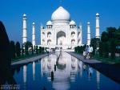
Tomb built by Shah Jahan 20 years to build and 20,000 men Bankrupted treasury and empire downfall
Taj Mahal

Slide 10
China
Emerging Empire
Flowering of Chinese Culture
China and the Larger World

Slide 11
Trade route

Slide 12
China
Confucianism: humanity, learning, family, peace and justice - Confucious
Buddhism: enlightenment through right conduct, wisdom and mediation releases one from desires and suffering
Daoism: simple honest life
Founded by Laozi

Slide 13
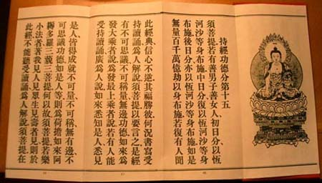
Diamond Sutra
The oldest printed book in the world about Chinese Buddhism. It folds out like an accordion.

Slide 14
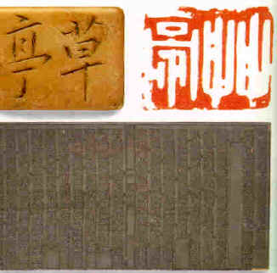
Invention: Printing
Wood block printing – carved characters which could be stamped speeding up the process of printing

Slide 15
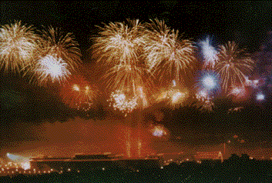
Invention: Gun powder
Gun powder used for fireworks

Slide 16
Invention: Cash-Coin
Square holes and strung together 1000 at a time on a red thread

Slide 17
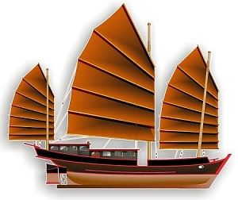
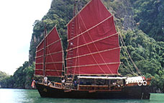
Junk
500 men in the flat bottom 3 times larger than anything in Europe
Real Junk in Vietnam

Slide 18
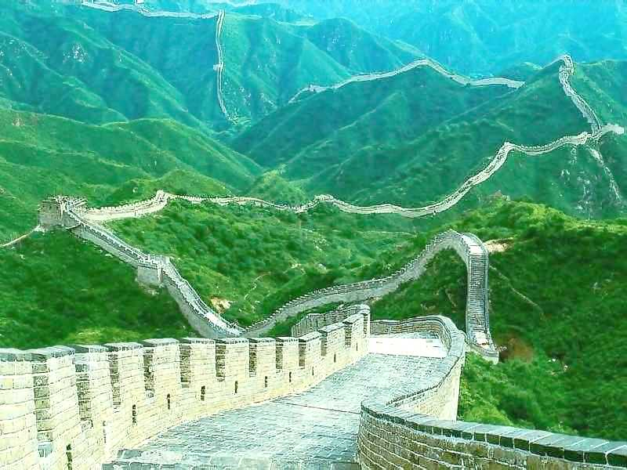
4,000 miles long Worlds longest cemetery Visible from the moon
Great Wall

Slide 19
Japan
Land of the Rising Sun
A Developing National Culture
Power of the Shoguns
Japan: Unified Yet Isolated

Slide 20
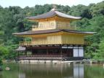
Japan
Golden Pavilion
Home of the Japanese Emperor

Slide 21
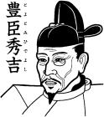
Toyotomi Hideyoshi
Most reverend hero because he rose to leadership from a peasant beginning
Equivalent to Abe Lincoln

Slide 22
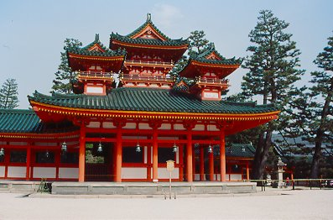
Shinto
Below is a Shinto shrine and it reminds people that all things in the natural world are filled with divine spirits {kami}

Slide 23
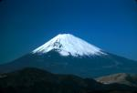
Mt. Fuji Extinct volcano
Japans highest mountain standing at 12,388 feet or 2.3 miles above sea level.

Slide 24
Lady Murasaki
Member of the elite Fujiwara clan. She wrote the world’s first novel Tale of Genji. It is about the loves and life of a prince. Women were not allowed to learn to read/write so she learned by being at her brother’s side. What we know about Japanese courting life has come from her writing.

Slide 25
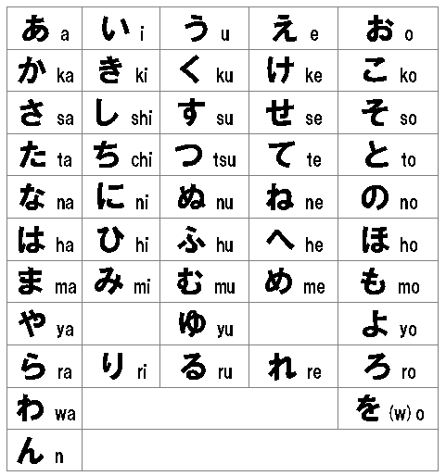
Hiragana
Each symbol stands for a syllable
Contrast to Chinese characters = word

Slide 26
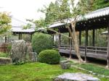
Zen
Sect of Buddhism. Personal enlightenment , rigid physical and spiritual discipline. Many samurai {Japanese warrior who most heroic deed was to die in battle} were Zen.
Zen garden:

Slide 27
Haiku
17 syllables, 3 lines {5,7,5} done in calligraphy, non rhyming
Nature & human emotions are common.
The flap of a bat, drip drip of monsoon waters. Ancient image stares.

Slide 28
This powerpoint was kindly donated to www.worldofteaching.com
http://www.worldofteaching.com is home to over a thousand powerpoints submitted by teachers. This is a completely free site and requires no registration. Please visit and I hope it will help in your teaching.

